Slide 1
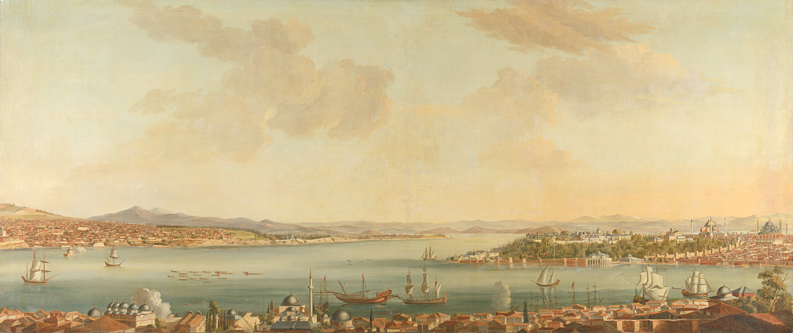

A Critical Analysis of The Old Man and The Sea
Presenter :
Syeda Sanjana Tasnim Preya (2020236028)
Reg No : 2020236028
Session : 20-21
Department of English
Shahjalal University of Science and Technology

Slide 2
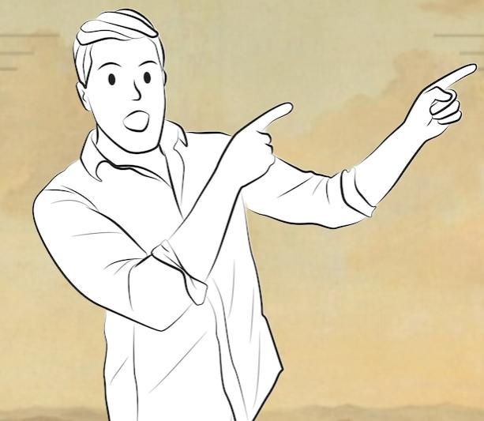
Exploring Ideas
Branding the American Self
Self-fashioning
Violence
Themes, Motifs, Symbols, Symbolism of Characters

Slide 3
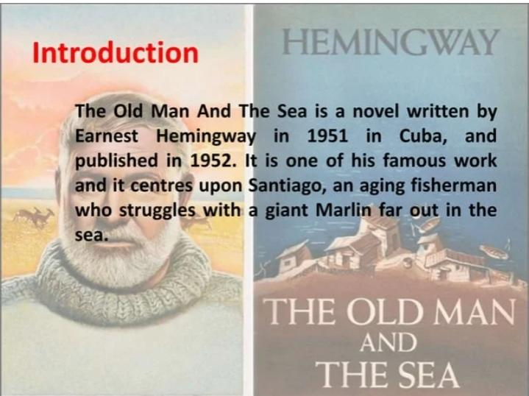

Slide 4

Branding the American Self
Creating an identity that reflects traditional American Values.
Independence, Determination, Hard-work, Resilience, Strength.
“ Brand” themselves.
“Self-made” Person
“American Dream”
Real-life Example:
Athletes
Business Person etc.

Slide 5

Self-fashioning
Shaping identities through Actions, choices, and beliefs.
Building own identities
Real life Example:
Dedicated learner

Slide 6

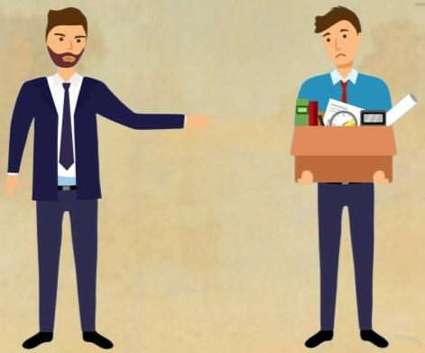
Violence
Symbolizes struggles or challenges
Test strength and Resilience
Fighting against world, nature or themselves.
Real life Example :
Jobless person
Dealing with serious illness

Slide 7

How the ideas are connected to The Old Man and the Sea
Perseverance
Self-made Person
“A man can be destroyed but not defeated “
American culture
Enduring pain and struggle
“I will fight them until I die”
Internal violence
Self-fashioning
Past victories
“EI Champeon” (The Champion)
Identity as a Proud and enduring fisherman
Branding the American self
Violence

Slide 8

Branding the American Self
in Ernest Hemingway’s
The Old Man and the Sea

Slide 9
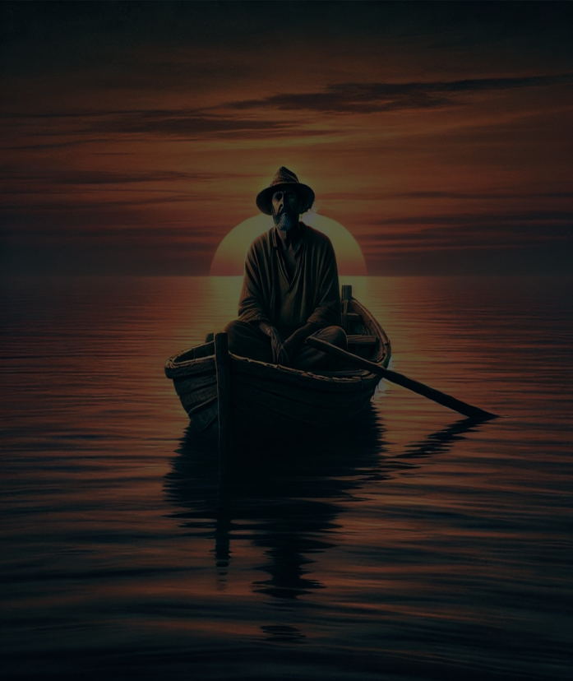
Santiago’s Individualism
Self-Sufficiency
“Now is no time to think of what you do not have. Think of what you can do with what there is.”
Accepting Solitary Role
“It is better to be lucky. But I would rather be exact. Then when luck comes you are ready.”
“I was a strange old man. Now is when I must prove it.”

Slide 10
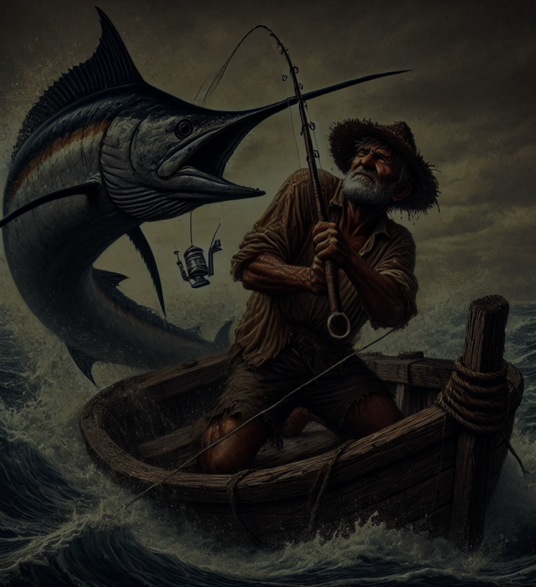
Santiago’s Resilience and Perseverance
Enduring Pain and Struggle
“Pain does not matter to a man.”
Connection to the Marlin
“I wish I could show him what sort of man I am . I am more man than I am and I will be so.”
Commitment to the Fight
“I will stay with you until I am dead.”

Slide 11
Self-fashioning
The Old Man and The Sea
Ernest Hemingway

Slide 12
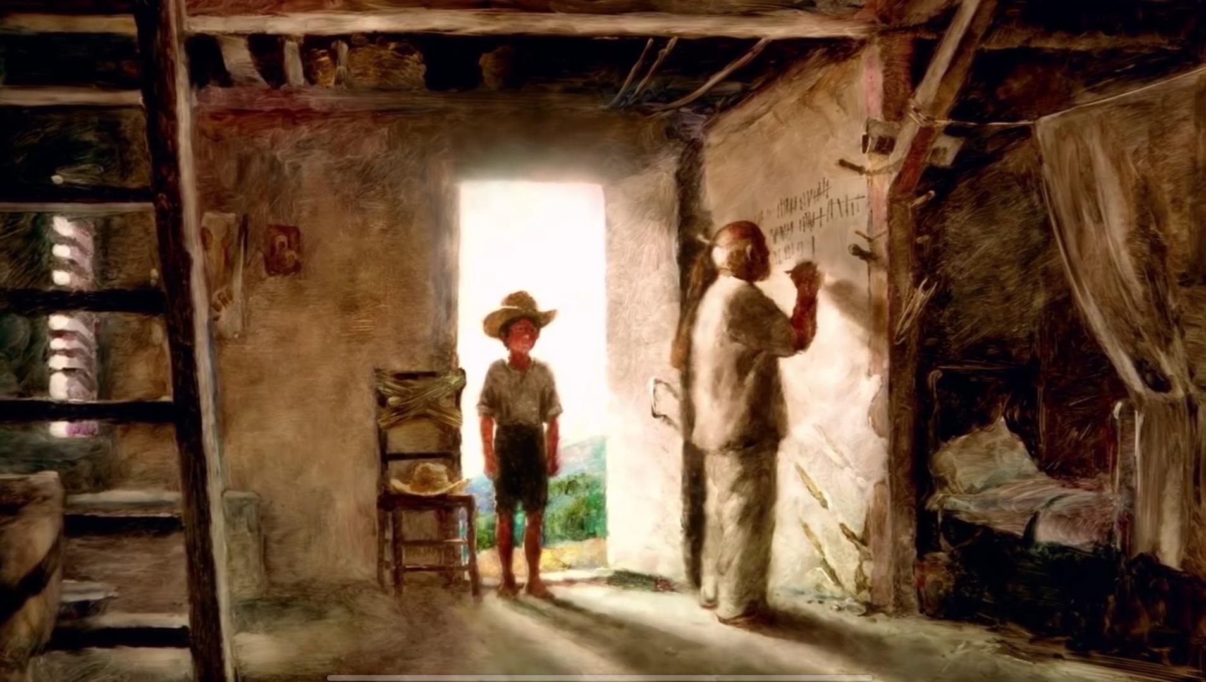
The boy: I could go With you again.
We‘ve made some money.
Santiago: No

Slide 13

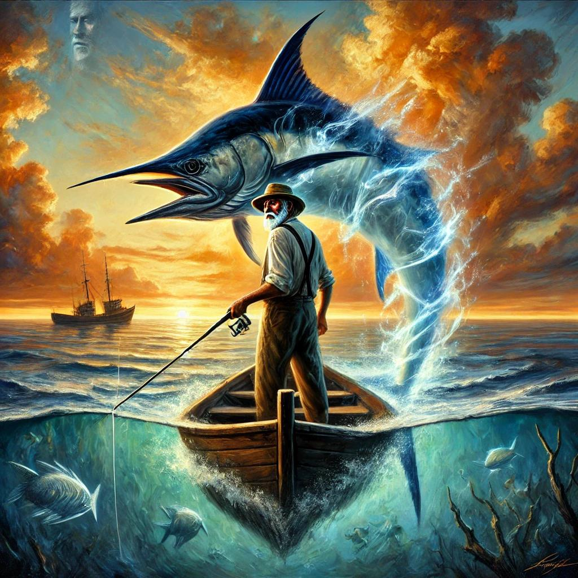
Societal Expectations
Personal Values Existential Challenges Building Own Identity

Slide 14
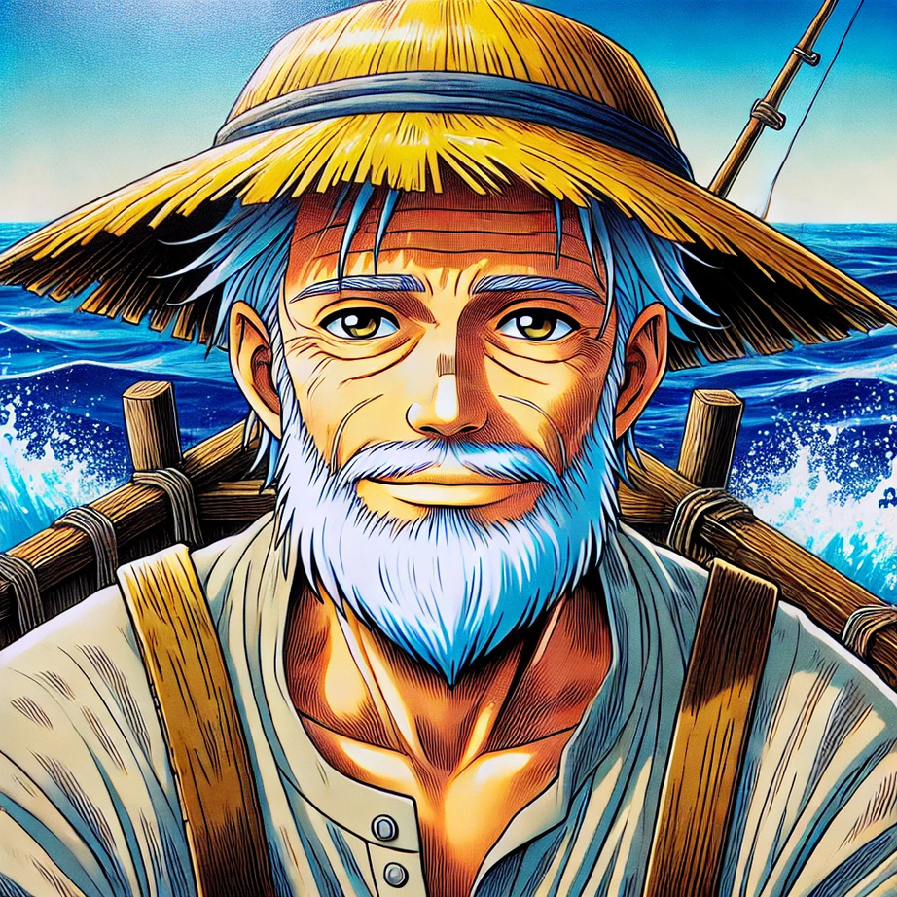
THE ROLE OF VIOLENCE IN SHAPING SANTIAGO’S IDENTITY
Quotes:
“You Killed him for pride and because you are a fisherman”
“ No one should be alone in their old age, he thought”

Slide 15
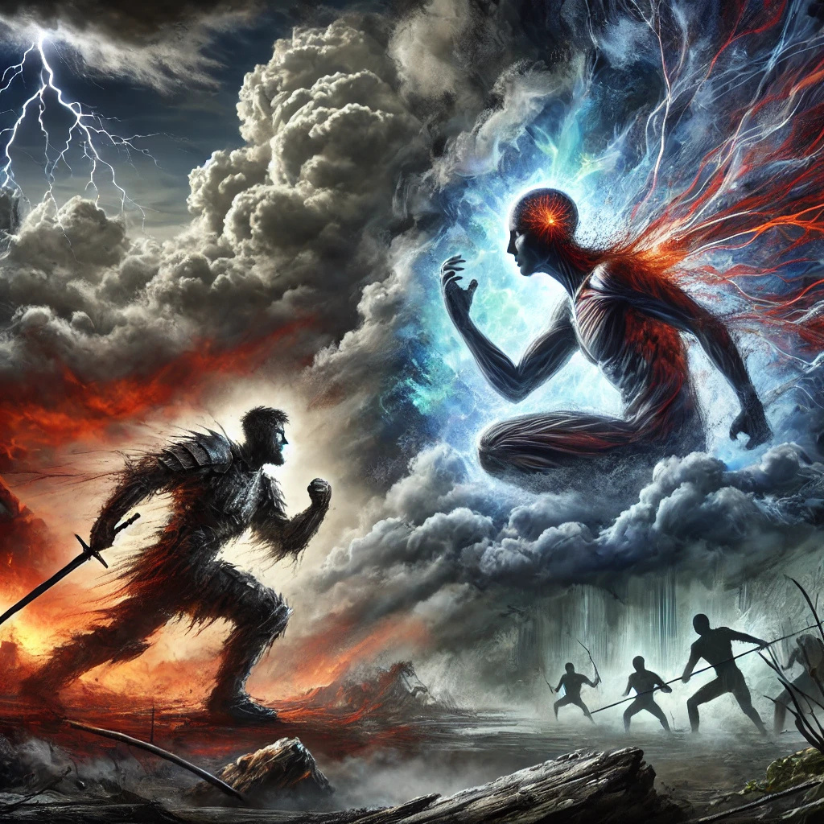

Physical Violence:
Battle with marlin: Test of Santiago's endurance.
Shark's Attack: Show nature's cruelty and inevitable loss.
Internal Struggle:
Self Doubt: Pushes Santiago to reflect his own worth.
Aging: Strengthens his will to find meaning in suffering.

Slide 16
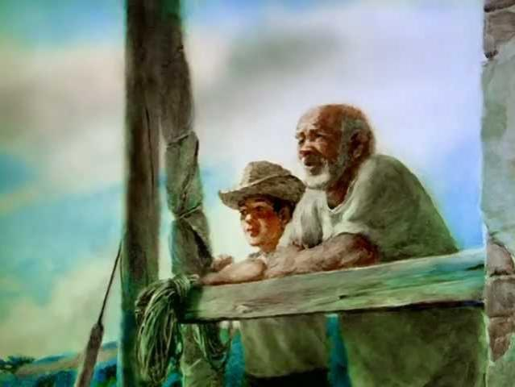
Themes
Struggle, Defeat &Death
Pride
Unity
Heroism
Manhood
Worthiness
Santiago as Christ

Slide 17
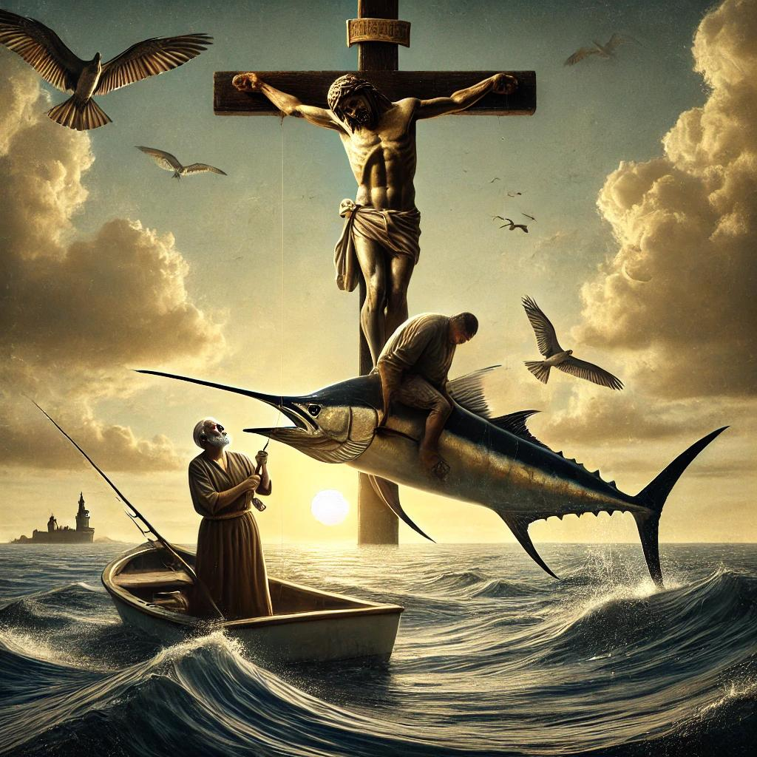
Motifs
Crucifixion Imagery
Christian Theology
Santiago and Christ
Life from death
Death- unavoidable force
Life- Possibility of Renewal

Slide 18
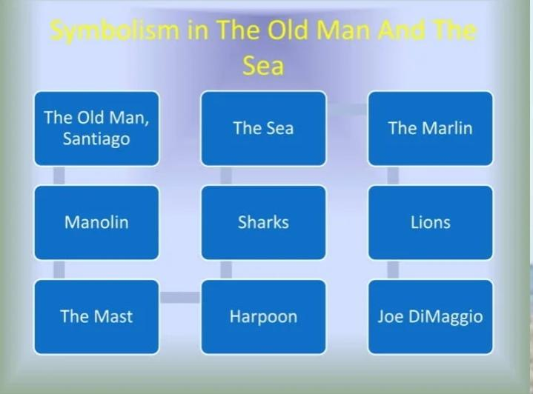

Slide 19
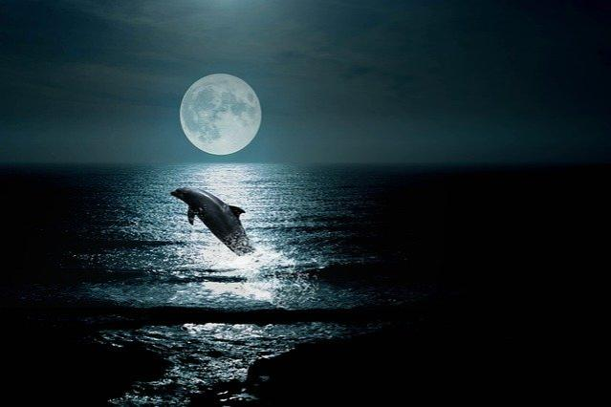
Symbols
The Marlin
Ideal opponent
Brings out the best
Strength, Courage, Respect

Slide 20
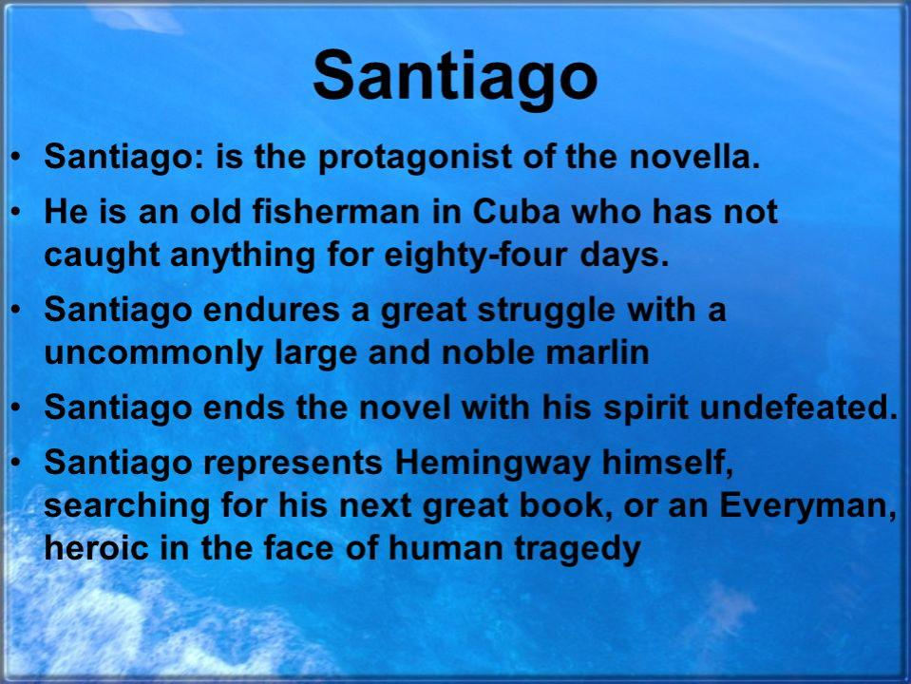
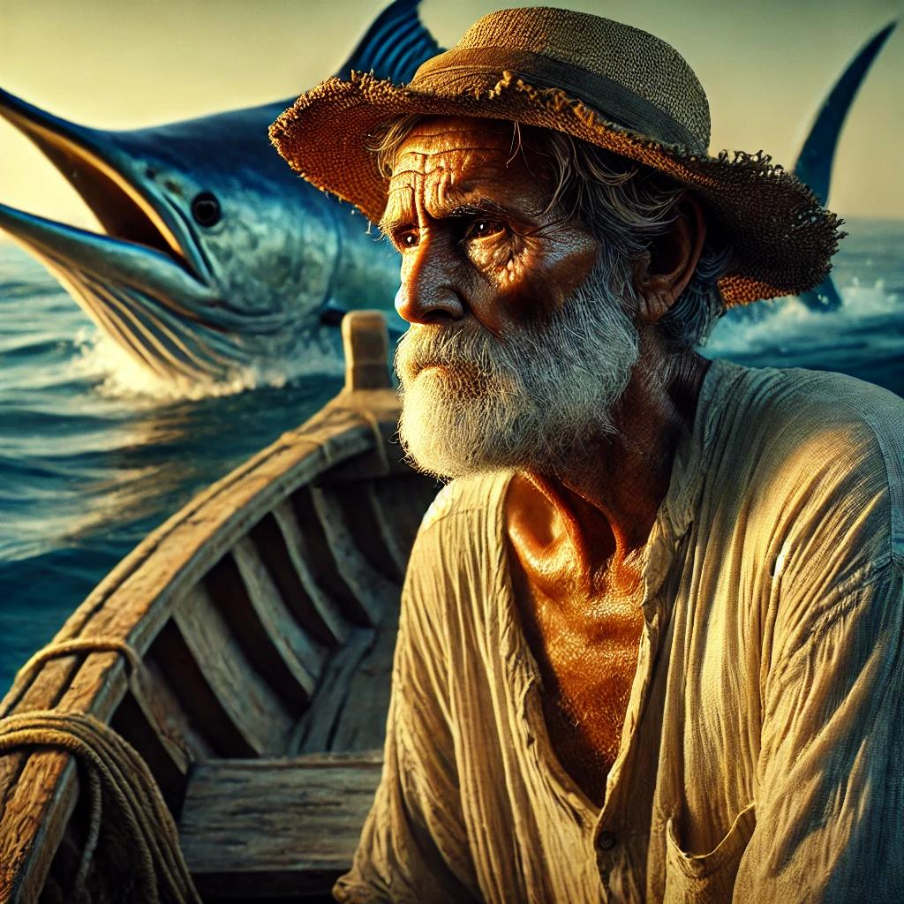

Slide 21
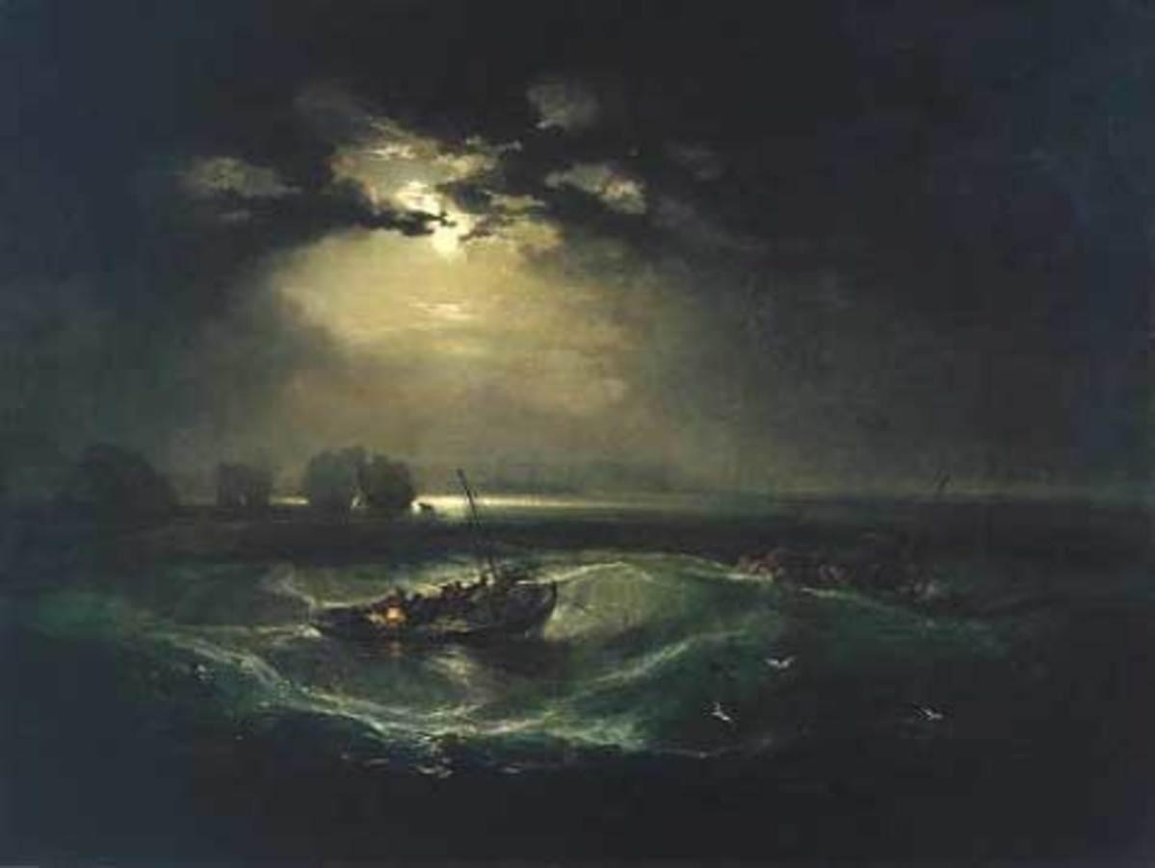
The sea
A great role
Main event
The universe
Isolation in the universe
Ultimate challenges, with no help and no recognition
Naturalism in literature
Lives by environment

Slide 22
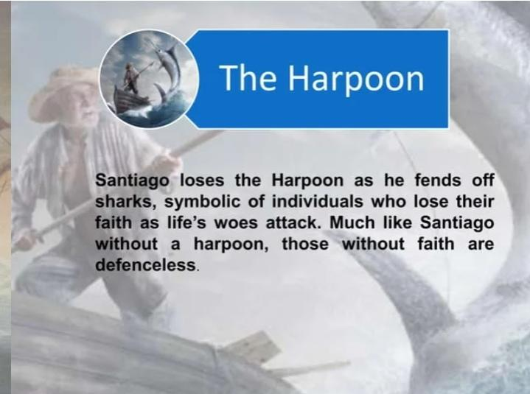

Slide 23
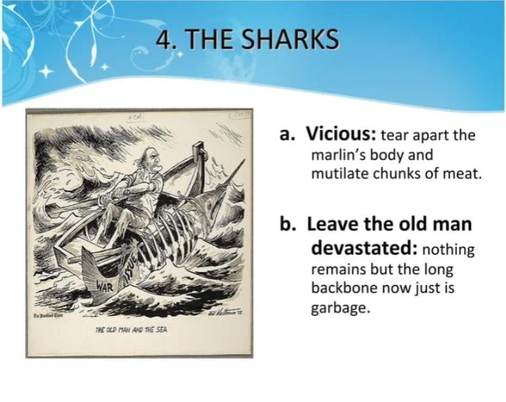
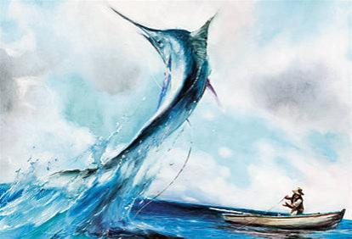

Slide 24
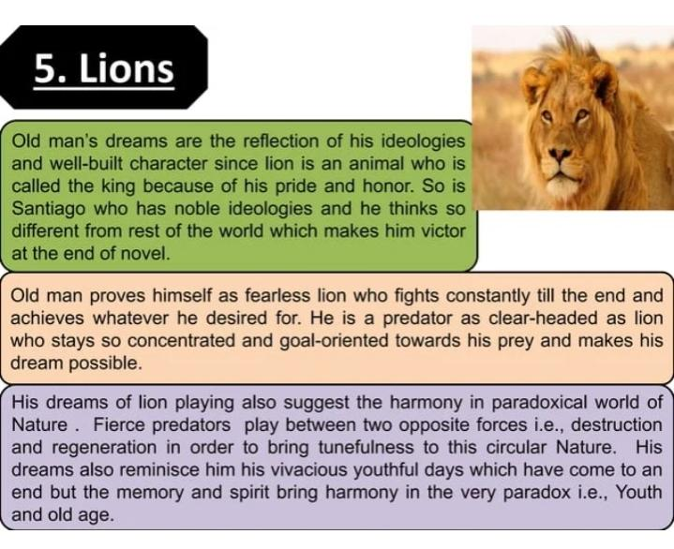

Slide 25
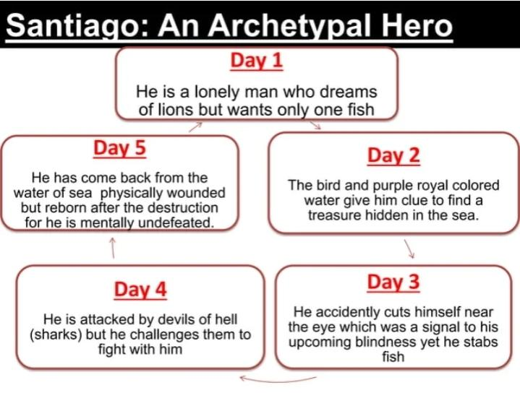

Slide 26
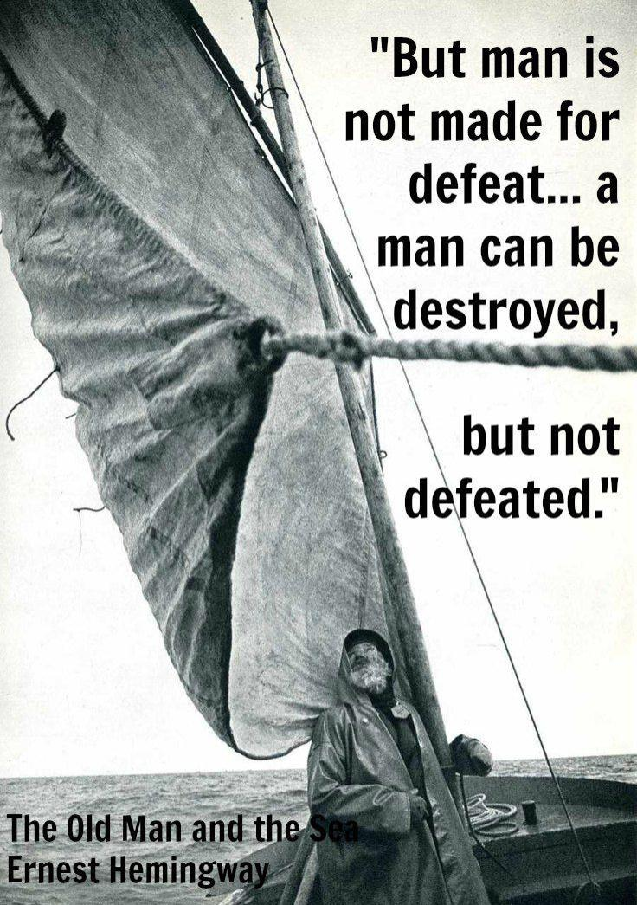
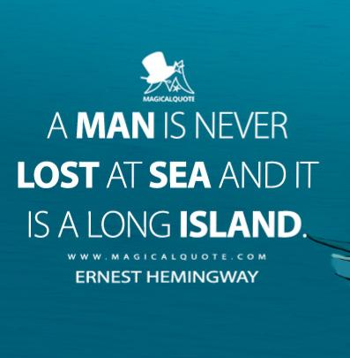
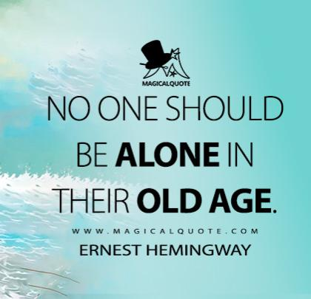
Some Important Quotations

Slide 27
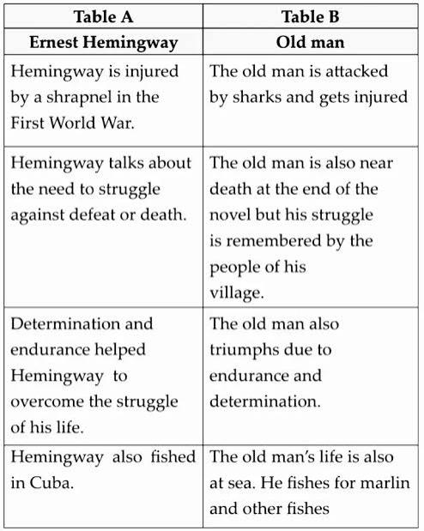
Hemingway vs Old Man

Slide 28
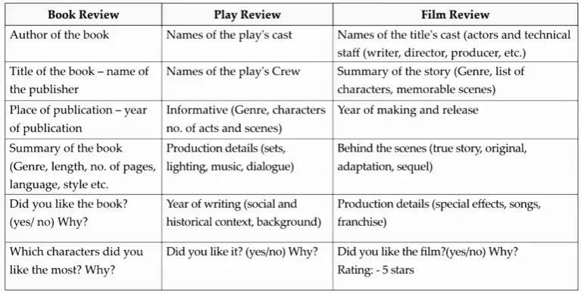

Slide 29
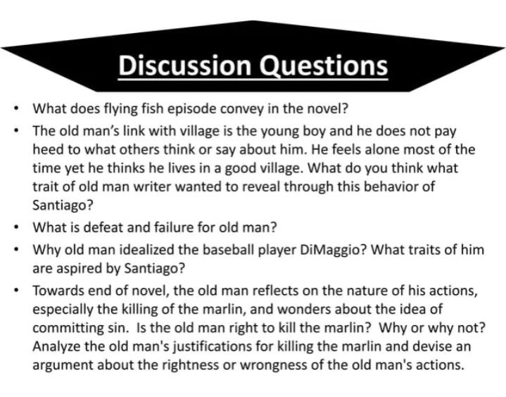

Slide 30
